Slide 1
Improved source of drinking water
CAPSTONE PROJECT
Presented By:
Student Name : Suraj ojha
College Name : Haridwar University
Department : B.Tech(CSE)
Faculty name : Mr Aman sir

Slide 2
OUTLINE
Problem Statement (Should not include solution)
Proposed System/Solution
System Development Approach (Technology Used)
Algorithm & Deployment
Result (Output Image)
Conclusion
Future Scope
References

Slide 3
Problem Statement
The Challenge: Access to safe and improved sources of drinking water remains a critical issue in India, especially in rural and underdeveloped regions. Despite ongoing efforts under the Sustainable Development Goals (SDGs), inequalities persist in water accessibility across states and socio-economic groups. This project aims to analyze data from the 78th Round of the Multiple Indicator Survey (MIS) to assess the percentage of the population with access to improved drinking water sources. It will also explore related indicators such as use of clean cooking fuel and migration trends. By identifying patterns and disparities, the study will generate actionable insights to support evidence-based policymaking. The ultimate goal is to help ensure equitable access to clean water and contribute to India's progress on SDG targets.

Slide 4
TECHNOLOGY USED
IBM cloud lite services
Natural Language Processing (NLP)
Retrieval Augmented Generation (RAG)
IBM Granite model

Slide 5
Proposed Solution
.
Proposed Solution:
Develop a smart drinking water monitoring system using AI and ML that continuously analyzes water quality data and predicts contamination.
How it Works:
Sensors measure pH, turbidity, TDS, temperature, and chlorine
Data is sent to the cloud in real time
ML models classify water as safe or unsafe and detect anomalies.
Technologies Used:
IoT sensors, Python, Machine Learning (Random Forest / LSTM), Cloud platform, Dashboard
Benefits:
Early contamination detection
Improved public health
Reduced manual testing
Faster decision-making

Slide 6
System Approach
The proposed system uses AI and Machine Learning to monitor, analyze, and predict drinking water quality in real time. Sensor data is collected, processed, and analyzed to detect contamination and support timely decision-making.
System requirements
Library required to build the model

Slide 7
Algorithm & Deployment
A Machine Learning classification and prediction model (Random Forest / LSTM) is used to analyze drinking water quality. Random Forest is chosen for its high accuracy and ability to handle non-linear relationships, while LSTM can be used for time-series prediction of future water quality trends.
Data Input
The algorithm uses the following input features:
pH level
Turbidity
Total Dissolved Solids (TDS)
Temperature
Training Process
The model is trained using historical water quality data. Data preprocessing includes cleaning, normalization, and feature selection. The dataset is split into training and testing sets, and techniques such as cross-validation and hyperparameter tuning are applied to improve model performance.
Prediction Process
The trained model predicts whether the water is safe or unsafe and forecasts potential quality degradation. Real-time sensor data is fed into the model to generate continuous predictions and trigger alerts when unsafe conditions are detected.

Slide 8
Result
The performance of the proposed machine learning model was evaluated using historical and real-time drinking water quality data. The model’s effectiveness was measured in terms of accuracy and its ability to correctly predict water safety levels.

Slide 9
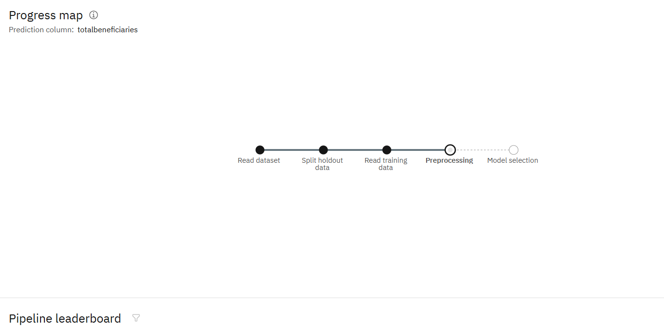
Result

Slide 10
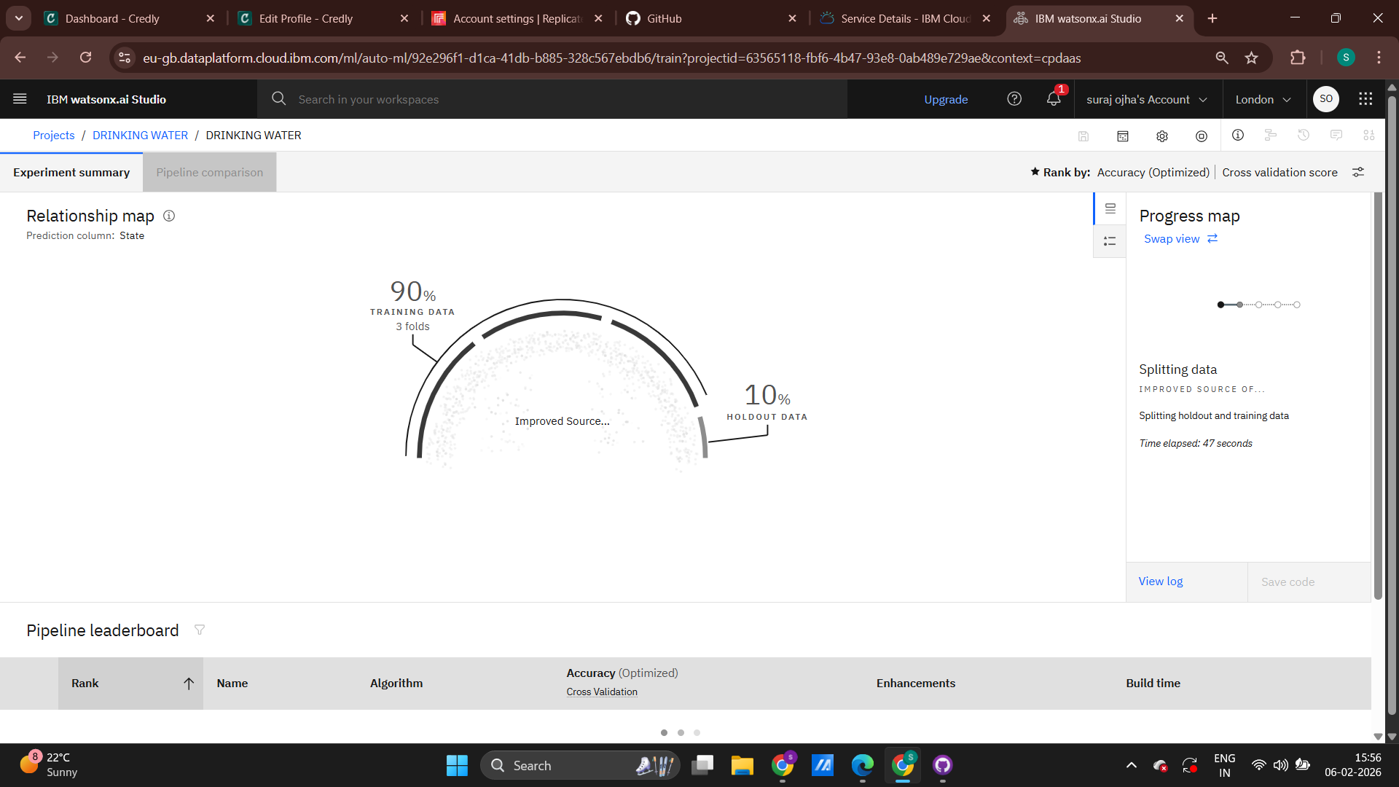
Result

Slide 11
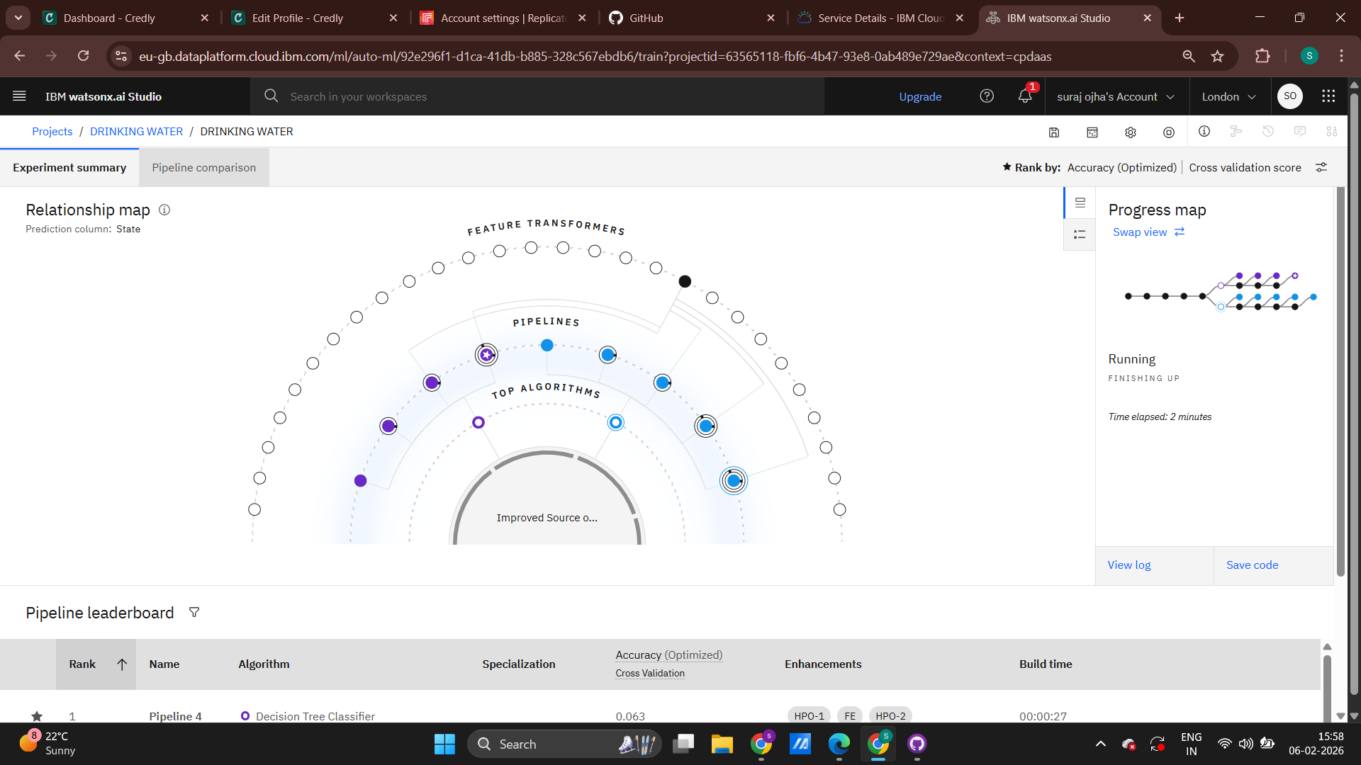
Result

Slide 12
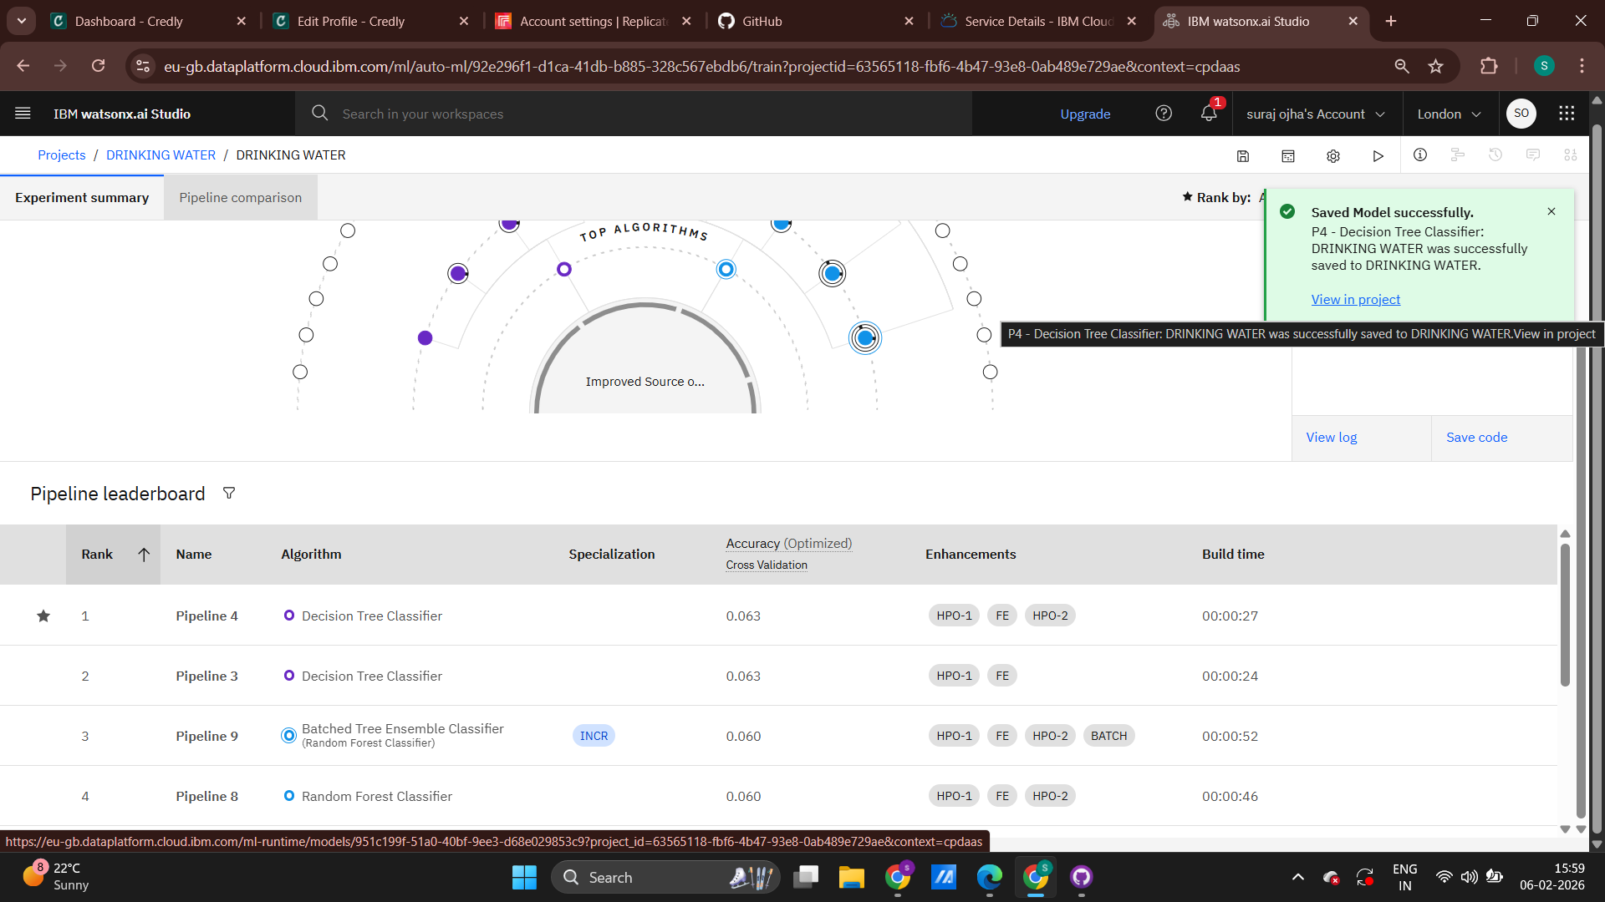
Result

Slide 13
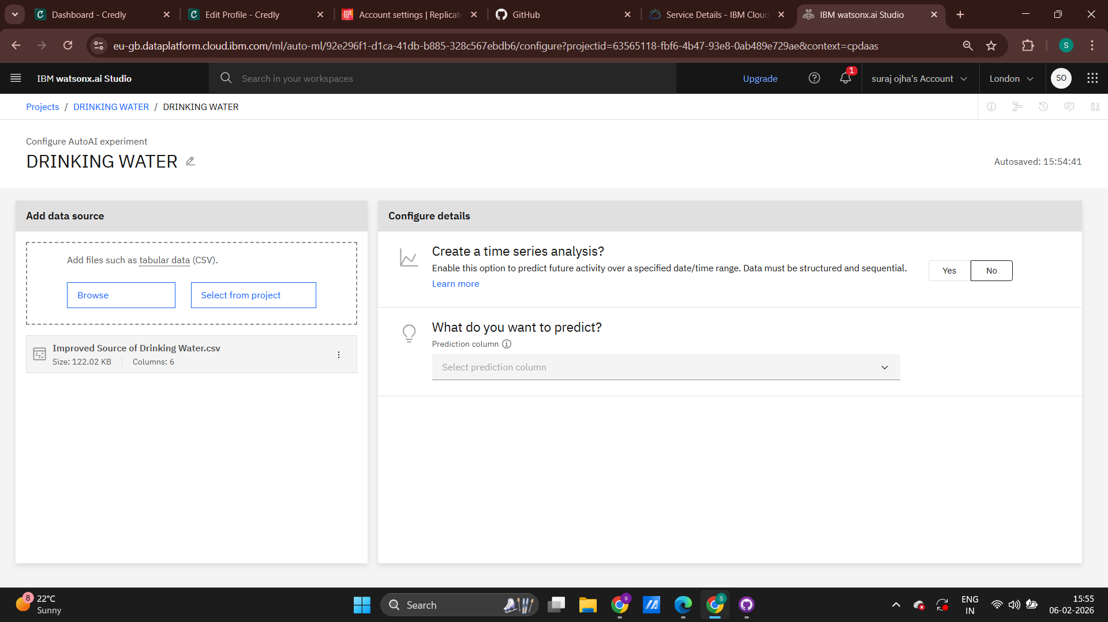
Result

Slide 14
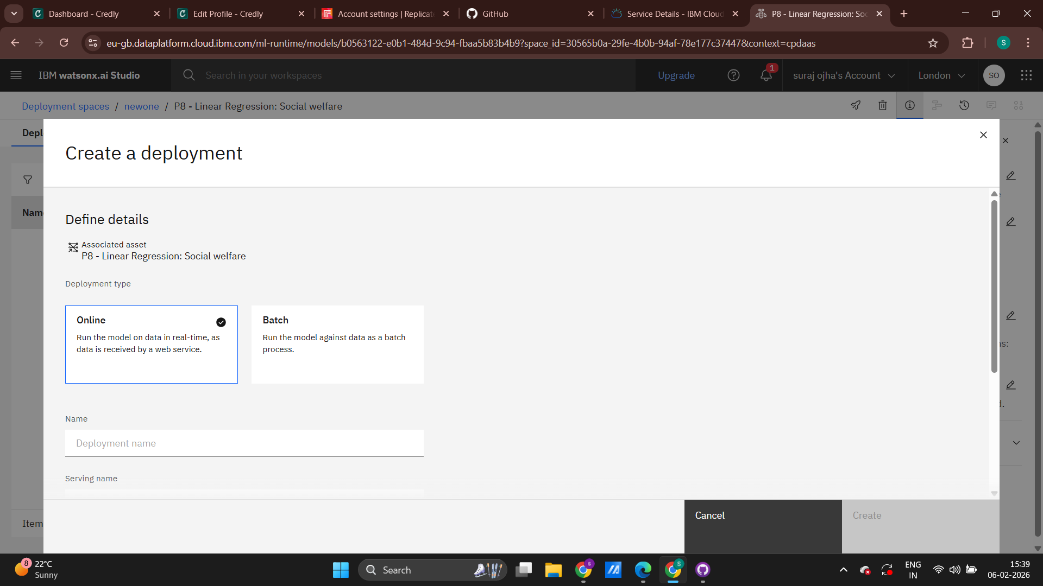
Result

Slide 15
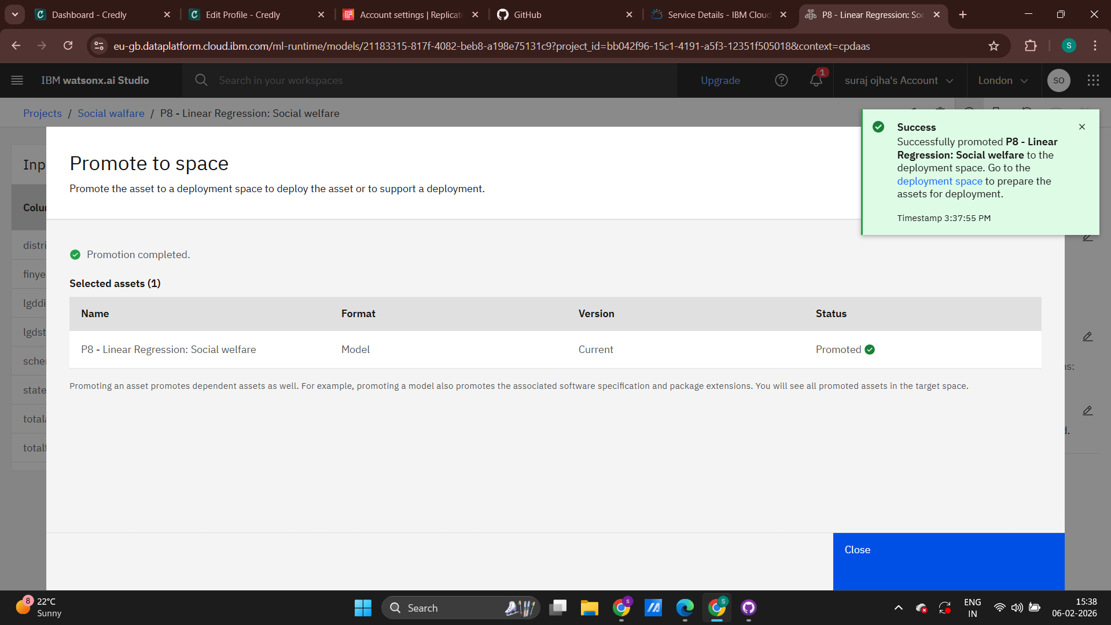
Result

Slide 16
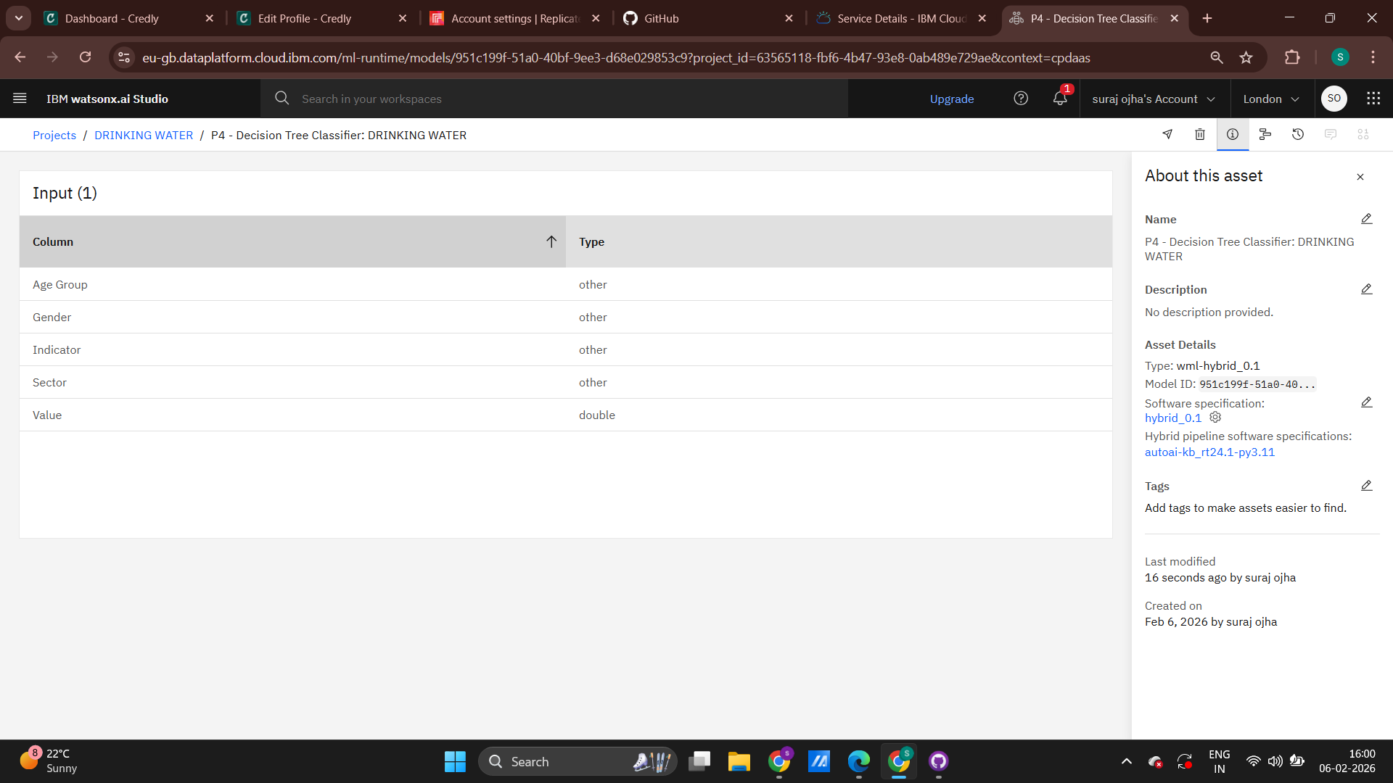
Result

Slide 17
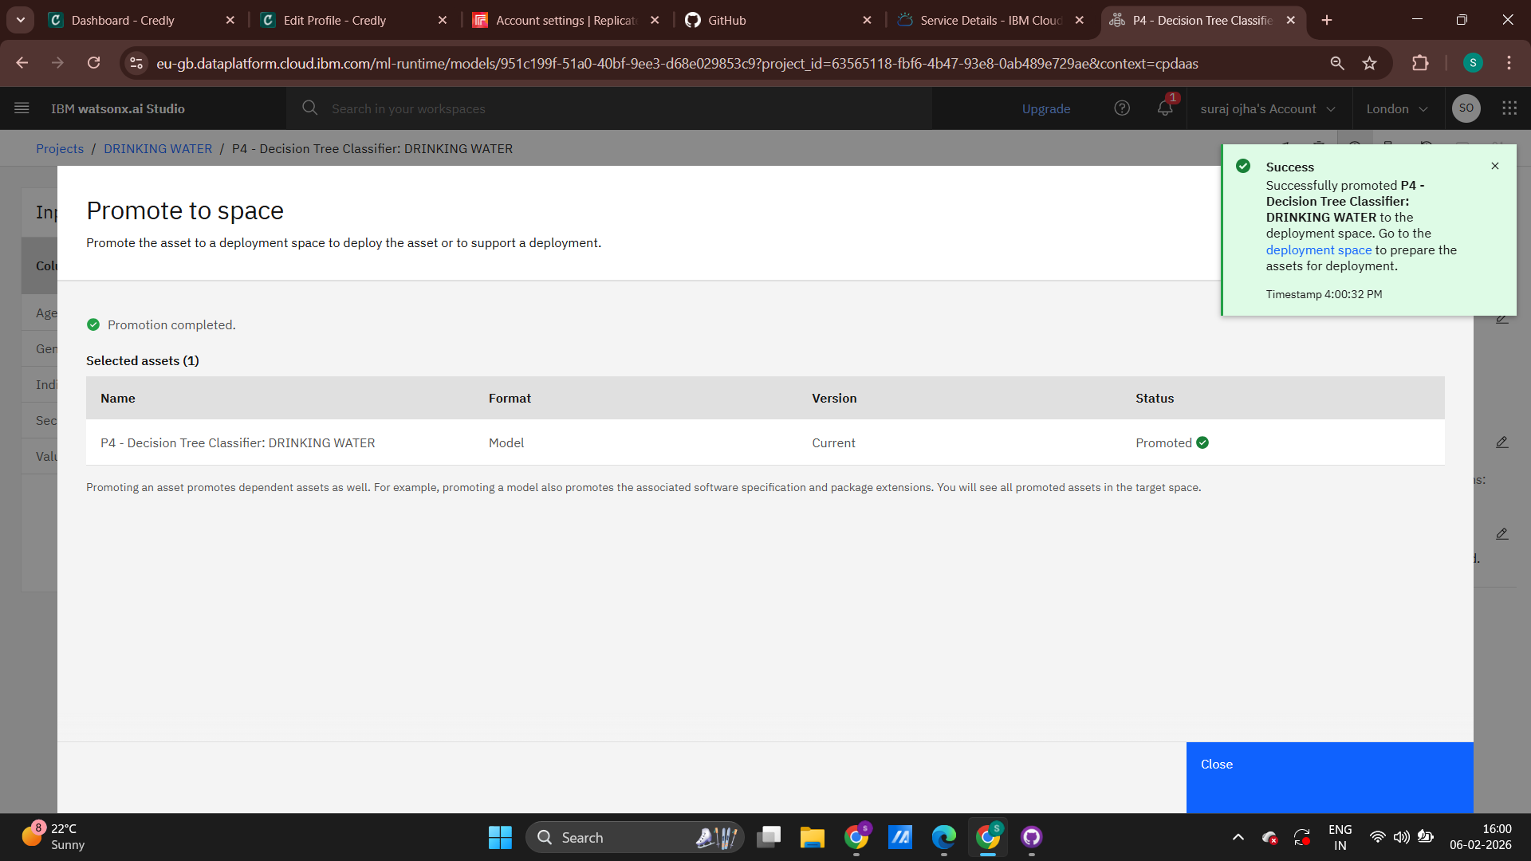
Result

Slide 18
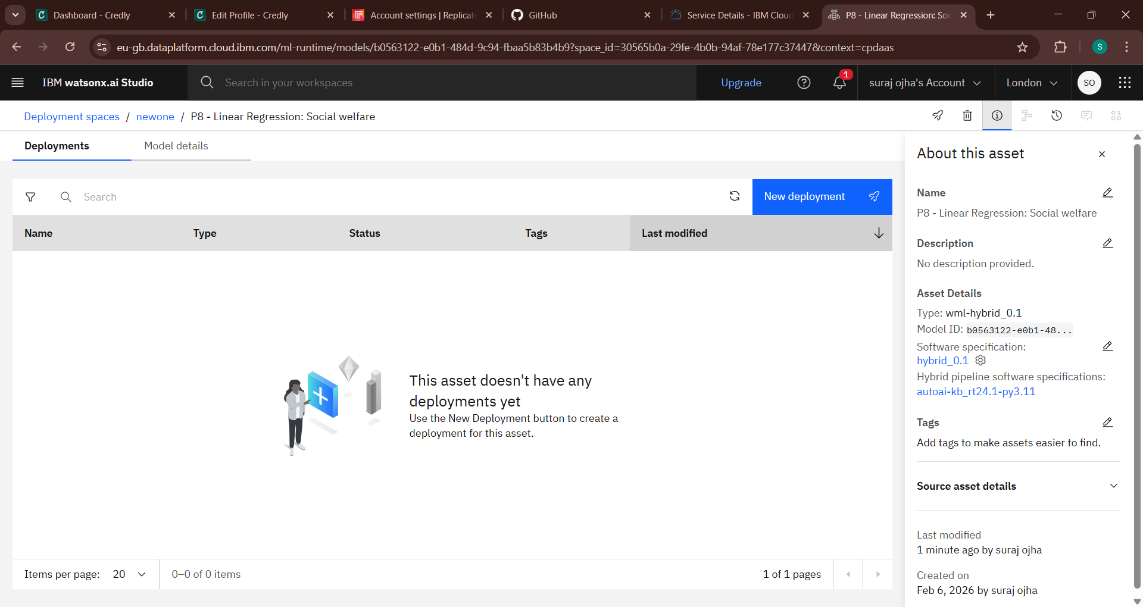
Result

Slide 19
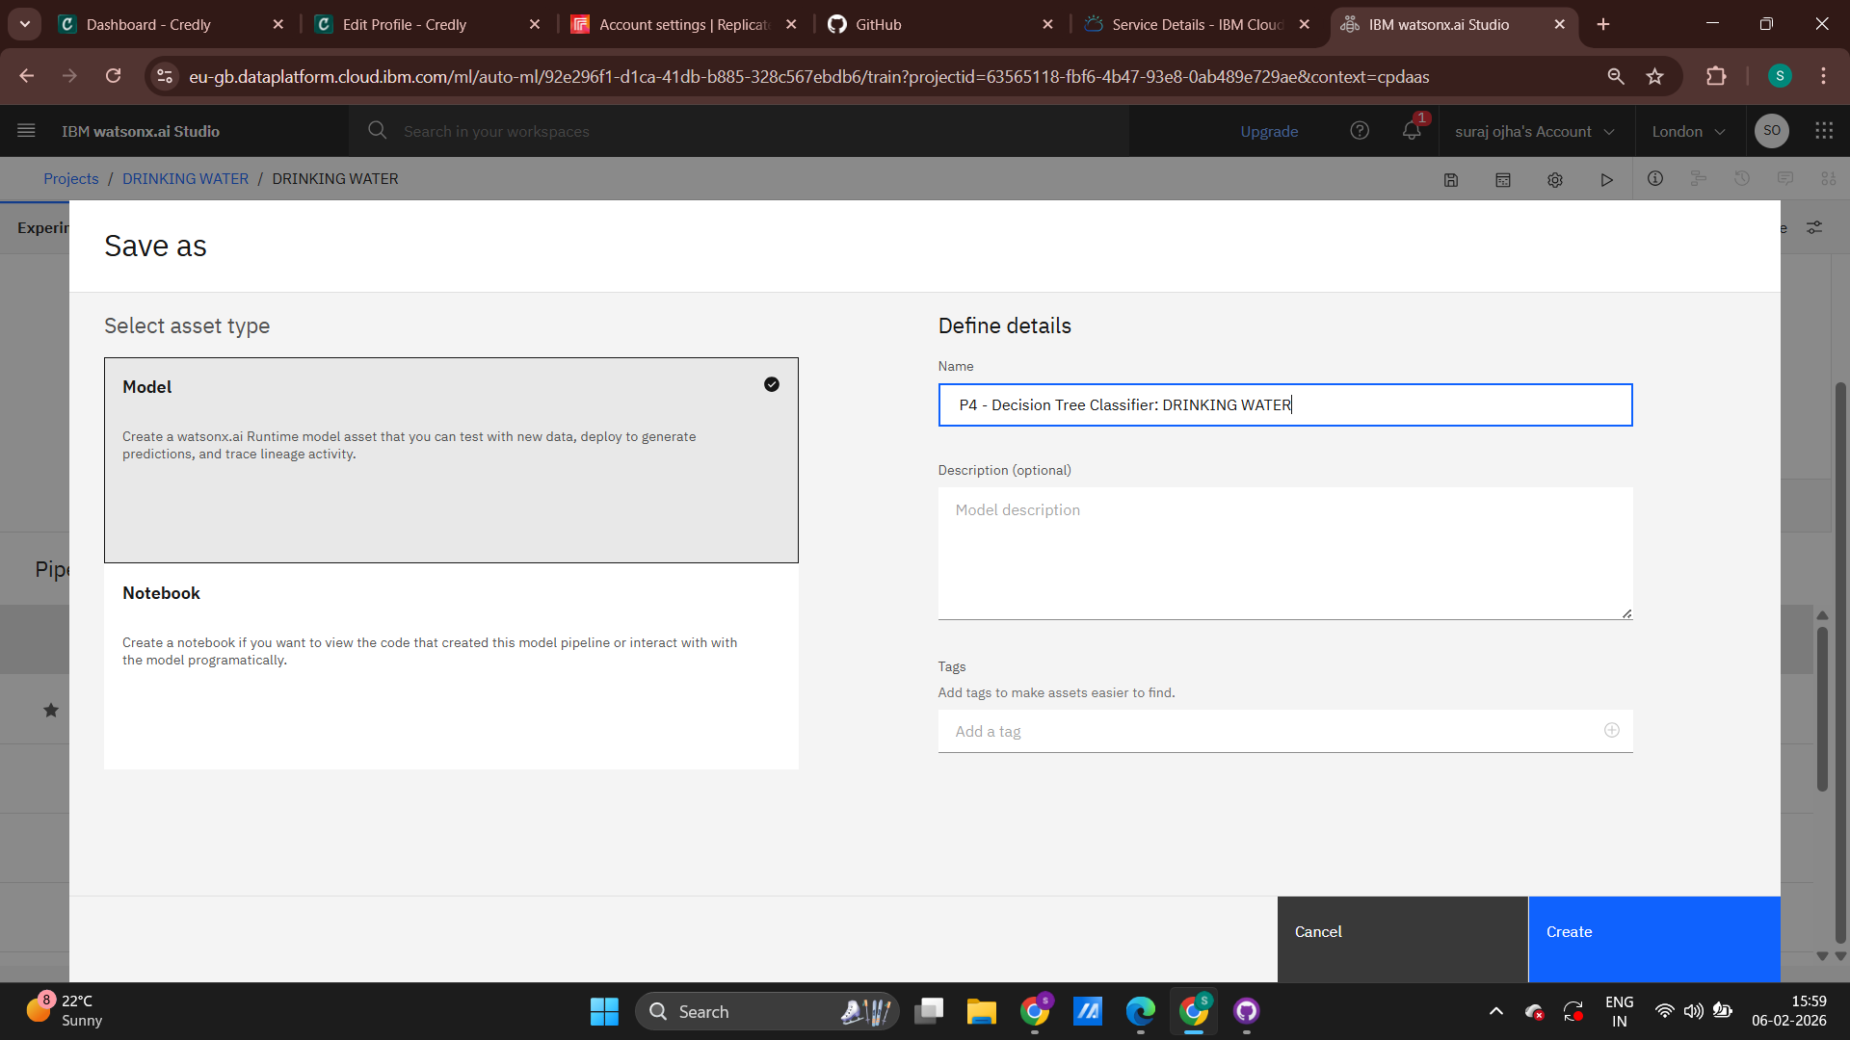
Result

Slide 20
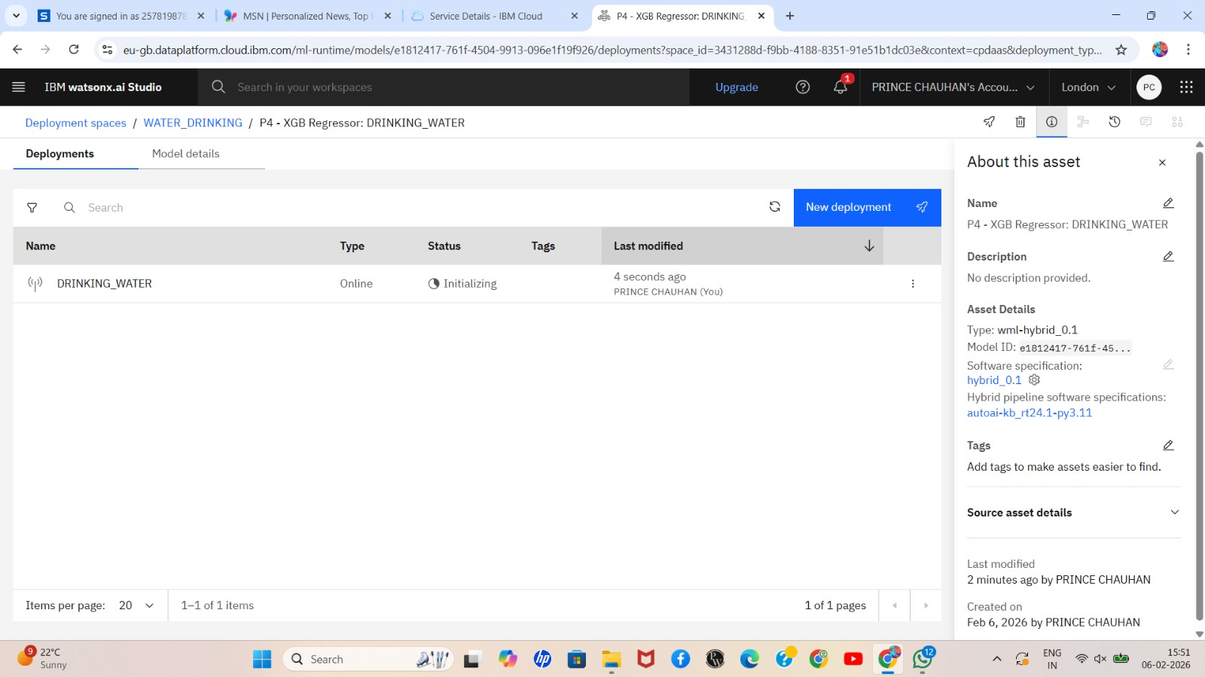
Result

Slide 21
Conclusion
This project successfully demonstrates the application of machine learning techniques for monitoring and predicting drinking water quality. By analyzing real-time and historical sensor data, the proposed system accurately classifies water as safe or unsafe and detects potential contamination at an early stage. The results show improved accuracy and effectiveness compared to traditional monitoring methods. Overall, the system provides a reliable, automated, and scalable solution for ensuring safe drinking water, supporting timely decision-making and enhancing public health protection.

Slide 22
GITHUB LINK
https://github.com/ojhasuraj65/spotify-recommendation-system

Slide 23
Future scope
Integration of advanced deep learning models to improve prediction accuracy.
Expansion of sensor parameters to detect biological and chemical contaminants.
Real-time mobile application for public awareness and authority alerts.
Integration with weather and satellite data to predict contamination risks in advance.
Deployment at a large scale across cities and rural areas for smart water management.
Use of blockchain technology to ensure data security and integrity.

Slide 24
References
World Health Organization (WHO), Guidelines for Drinking Water Quality.
U.S. Environmental Protection Agency (EPA), Drinking Water Standards.
Breiman, L., “Random Forests,” Machine Learning Journal.
UCI Machine Learning Repository, Water Quality Dataset.
Géron, A., Hands-On Machine Learning with Scikit-Learn and TensorFlow.

Slide 25
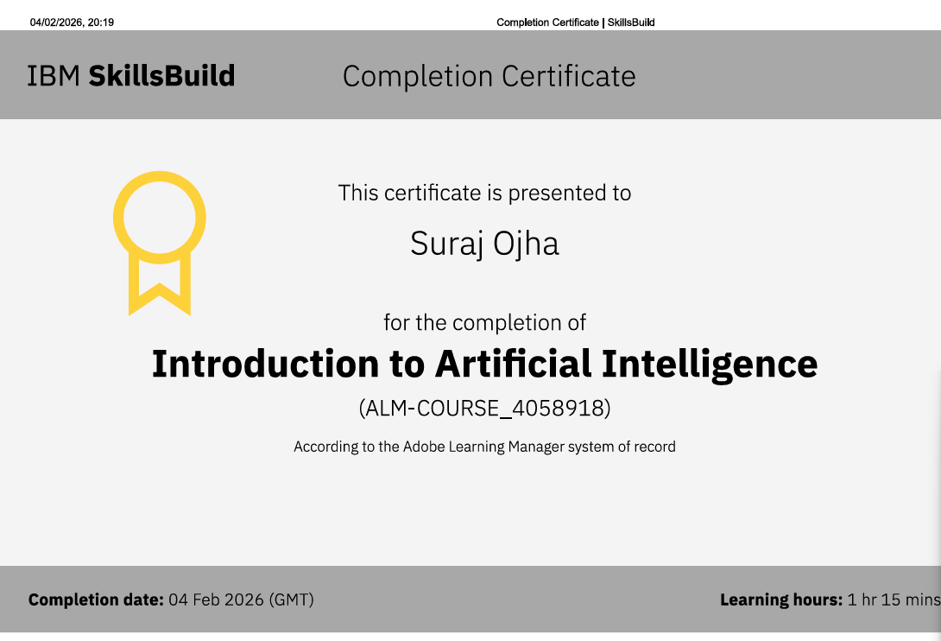
IBM CERTIFICATIONS

Slide 26
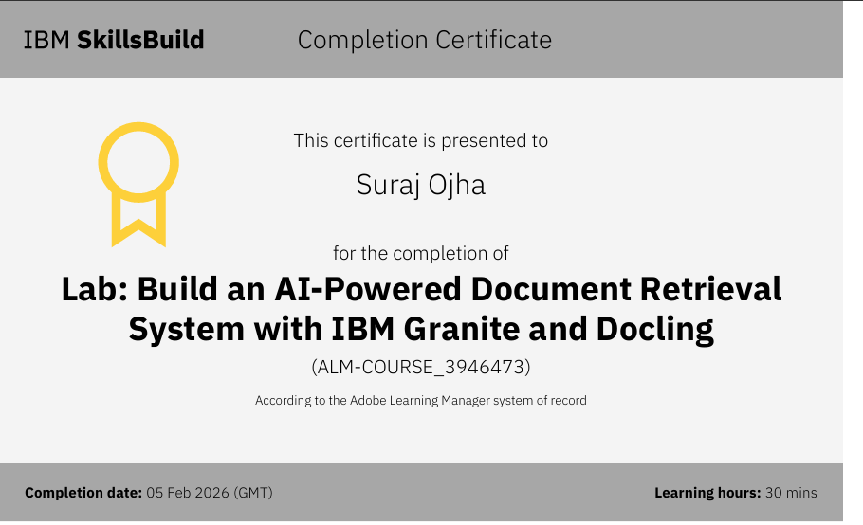
IBM CERTIFICATIONS

Slide 27
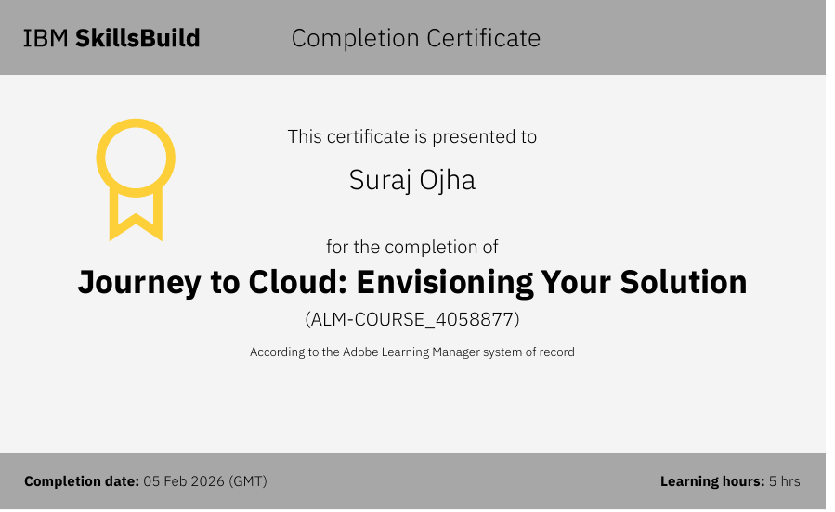
IBM CERTIFICATIONS

Slide 28
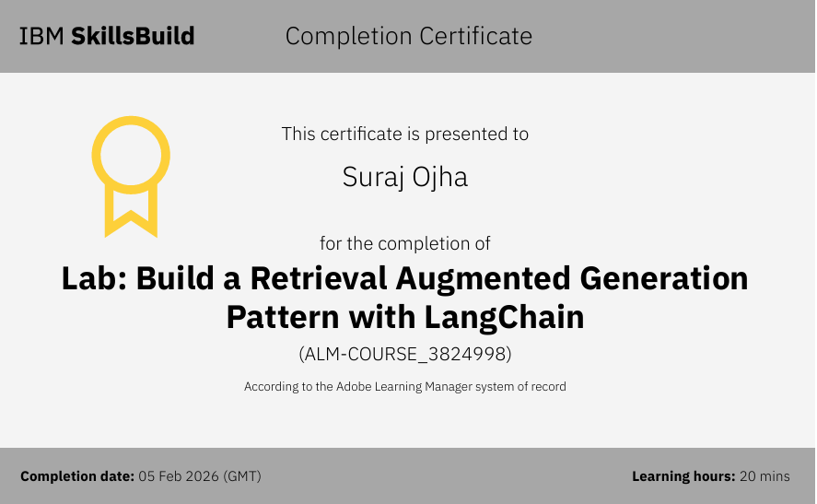
IBM CERTIFICATIONS

Slide 29
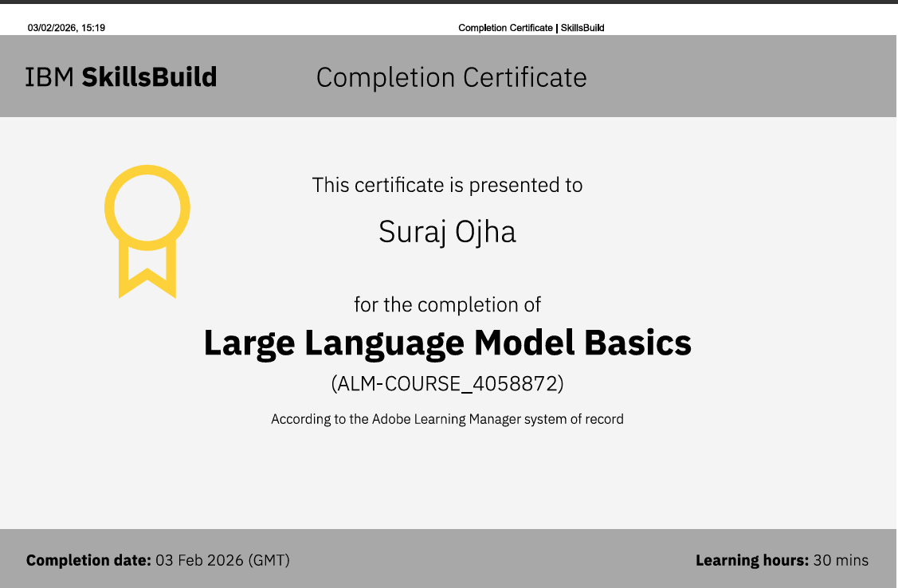
IBM CERTIFICATIONS

Slide 30
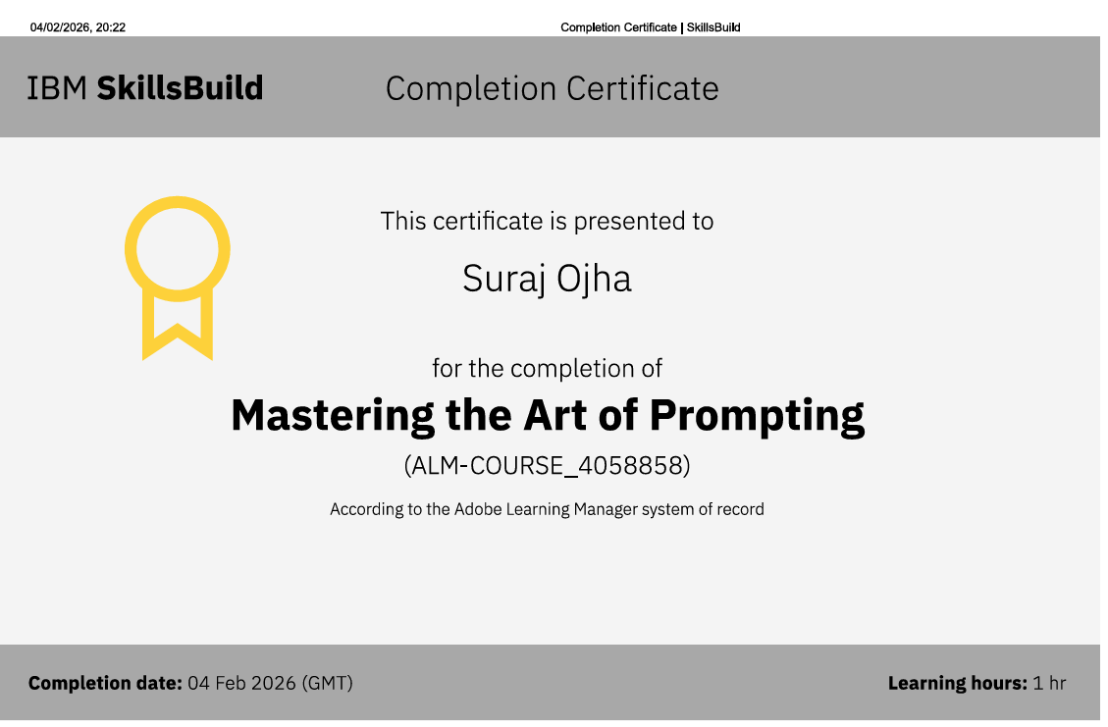
IBM CERTIFICATIONS

Slide 31
THANK YOU

